Slide 1
C++ classes
Fresher Learning Program
Notes:
© 2006 Capgemini - All rights reserved

Slide 2
Classes
Classes are an enhancement over struct in C, while struct’s members are public by default. A class’s members are private by default.
When we define a class, we can inherit members and data from it. This is called Inheritance.
Generic groups of classes are defined as templates. These may be to define an algorithm across several data-types.
© 2011 Capgemini - All rights reserved

Slide 3
Defining a class
Class declaration
  class Shape
  {
  int type;
  short int length;
  short int breadth;
  public:
  int area();
  };
Class function definitions
int Shape::area() {
int ret =0;
switch(this. type) {
case RECTANGLE:
ret = this.length x this.breadth;
break;
case SQUARE:
ret = length x length;
break;
}
return ret;
}
© 2011 Capgemini - All rights reserved

Slide 4
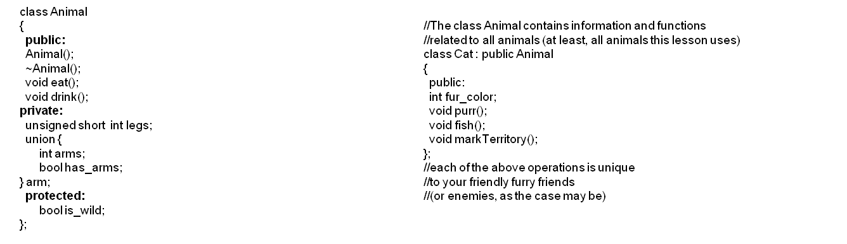
Classes and Inheritance
public: can be accessed from another file
private: class only, derived class may not access these
protected: Class & derived only
© 2007 Capgemini - All rights reserved

Slide 5
Templates
A single template provides a function definition that can suport multiple data-types.
The example shown provides GetMax functionality to both integer and float data-type.
// Program to overload template functions
#include <iostream>
template <class T>
T GetMax ( T a, T b) {
T result;
result = (a>b) ? a: b;
return (result);
}
int main () {
int i=10, j=6, k;
long l=15, m=11,n;
k=GetMax(i,j);
n=GetMax(l,m);
std::cout << k << std::endl;
std::cout << n << std::endl;
return 0;
}
© 2011 Capgemini - All rights reserved

Slide 6
Scope resolution operator
External to main, Example:
#include <iostream>
using namespace std;
int value1=10, value2=5;
int main () {
int value1=15;
cout <<value1<<endl; // value1 within main
cout <<::value1<<endl; // value1 outside main function
cout<<value2<<endl; // value2 outside main does not require Scope resolution
return 0;
}
Class members such as : Instance-name::Symbol
this scope: Instance function names can access their own variables using keyword this
© 2011 Capgemini - All rights reserved

Slide 7
Constructors for Objects – which one to use ?
class A {
private:
int val;
public:
A() { val=0; cout << "Default ctor called "<<endl;}
A(const A& A1) { val = A1.val; cout <<"Copy ctor A(A1) called"<<endl;}
A (int rval) {val=rval; } // Conversion constructor
};
Constructor is a special member function that intializes the objects of a class
A A1; // default
A A3(15); // constructor with one argument
A A2 = new A(A3); // copy constructor
© 2011 Capgemini - All rights reserved

Slide 8
Destructors – Garbage collection
A destructor is called when an object goes out of scope
Each object created using new must be freed using delete
A destructor may be define as
  ~Class-name(){}
The ~ (tilde) symbol is used at the beginning to declare the destructor
Example:
  ~A() {
    cout <<“Desctructor called \n”<<endl;
    val =0;
    }
© 2011 Capgemini - All rights reserved

Slide 9
Thank You For Your Time
Notes:
© 2006 Capgemini - All rights reserved

